Slide 1
45 Day Check-in
GO Team Meeting #3
December 14, 2022

Slide 2
Agenda
CIP-45 Day Check-in
School Strategic Plan
Discussion on Strategic Plan and progress
Updates for Strategic Plan (as necessary)
Preparing for the Budget Development
Rank Strategic Priorities

Slide 3
Timeline for GO Teams
You are HERE
1
2
3
4
5
1
2
3
4
5
Fall 2021
GO Team Developed 2021-2025 Strategic Plan
Summer 2022
School Leadership completed Needs Assessment and defined overarching needs for SY22-23
August 2022
School Leadership completed 2022-2023 Continuous Improvement Plan
Sept. – Dec. 2022
Utilizing current data, the GO Team will review & possibly update the school strategic priorities and plan
Before Winter Break
GO Team will take action (vote) on the school’s strategic plan and vote on the ranked strategic plan priorities for SY23-24 budget discussions.

Slide 4
Quarterly CIP Check-in
As part of the Continuous Improvement process, all APS schools are completing a quarterly check-in for the Continuous Improvement Plans.
Questions to Consider
Based on our year long CIP plan, what are the actions that the school has already completed?​
What data supports the completion of an action step and success criteria (both implementation and student achievement)?

Slide 5
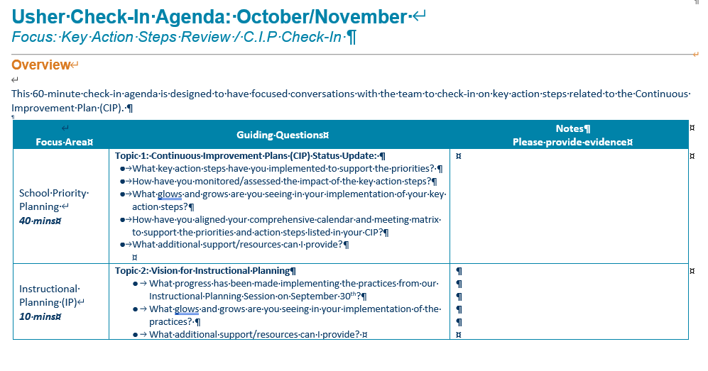

Slide 6
CIP Check-In
Goals #1 & 2 – Literacy and Math
Holding bi-weekly data meetings to analyze teacher and student data.
Implementing small group instruction with extended literacy block.
Monitoring the implementation of Fundations.
Providing intervention in Reading and Math to all students using HMH.

Slide 7
CIP Check-In
Goal 3 – Attendance
Providing monthly incentives for students and classes with perfect attendance.
Meeting with the CARE TEAM and SAC to identify students with attendance concerns.
Holding family engagement activities and providing incentives to communicate attendance expectations.

Slide 8
Strategic Plan Progress

Slide 10
GADOE Comprehensive Support & Improvement (CSI)
Average Ranking from the last 3 CCRPI Data Reports
Spring Results from SY 2018, 2019, 2022
Content Mastery (Proficiency)

Slide 11
Winter MAP DATA

Slide 12
Teacher Star Incentives – We’re Growing!!
Growth % | Star Posted | Represents ONE Class | Subject | % of students that met or exceeded in that class
50- 59% Growth |  | 4th Grade Class 4th Grade Class 3rd Grade Class 5th Grade Class | Math Math Reading Math | 54% 55% 51% 59%
60- 69% Growth |  | Kinder Kinder Kinder 1st Grade 1st Grade ^{4th} Grade 5th Grade | Math Reading Math Reading Math Reading Reading | 69% 69% 60% 67% 61% 60% 67%
70-79% Growth |  | Kinder Kinder | Math Reading | 78% 70%
80- 89% Growth 90% and above |  | Kinder Kinder | Math Reading | 83% 100%

Slide 13
Activity & Discussion
Review the priorities and goals in your strategic plan and reflect on if the expected progress is being made. These guiding questions will help you determine what, if any, updates are needed for your school’s strategic plan.
Are all CIP Goals reflected in our Strategic Plan Priorities? If not, which CIP Goal(s) are missing and should be added to the Strategic Plan?
Yes, all goals are reflected in the plan.
Missing – More frequent Checkpoints and Monitoring
What progress has been made towards the priorities identified in our Strategic Plan? What evidence/data do we have?
Staff is fully engaged in data meetings and small group strategies to improve literacy and math.
Teacher Growth Data
Based upon available data, are there any other adjustments we need to make to the Strategic Plan?
Continuous Writing Workshops with students and teacher.
Continuous check-ins, monitoring, and feedback.

Slide 14
Updates to the
Strategic Plan
Enter all changes/updates to your plan – be sure to include accountability measures, as appropriate.

Slide 15
Questions?
Wonderings?
Comments?

Slide 16
Preparing for Budget Development

Slide 17
You are HERE
1
2
3
4
5
1
2
3
4
5
Fall 2021
GO Team Developed 2021-2025 Strategic Plan
Summer 2022
School Leadership completed Needs Assessment and defined overarching needs for SY22-23
August 2022
School Leadership completed 2022-2023 Continuous Improvement Plan
Sept. – Dec. 2022
Utilizing current data, the GO Team will review & update the school strategic priorities and plan, as needed
Before Winter Break
GO Team will take action (vote) on the school’s strategic plan and vote on the ranked strategic plan priorities for SY23-24 budget discussions.

Slide 18
Action on the Updated Strategic Plan
The GO Team needs to TAKE ACTION (vote) on its updated Strategic Plan. After the motion and a second, the GO Team may have additional discussion. Once discussion is concluded, the GO Team will vote.

Slide 19
Discussion
Strategic Plan Priority Ranking
In preparation for the 2023-2024 Budget Development (January–March 2023), the GO Team needs to rank its Strategic Plan Priorities. Use the next slide to capture the priority ranking.

Slide 20
Strategic Plan
Priority Ranking
Insert the school’s priorities from Higher to Lower
Higher
Lower

Slide 21
Action on the Strategic Plan Priorities
The GO Team needs to TAKE ACTION (vote) on its ranked Strategic Plan Priorities. After the motion and a second, the GO Team may have additional discussion. Once discussion is concluded, the GO Team will vote.

Slide 22
Where we’re going
At our next meeting(s) we will begin the discussion of the 2023-2024 budget.
Let me or the Chair know of any additional information you need for our future discussion.

Slide 23
Thank you

